Slide 1
Transposition
Transposition

Slide 2
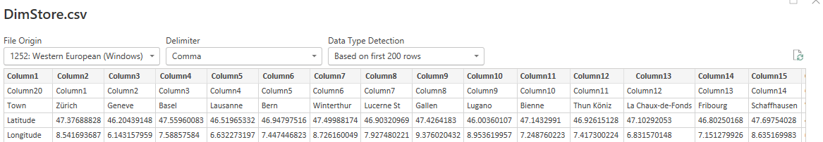
Transposition
Note: This lab uses the DimStore.csv file located in the Advanced Transformations folder
Power Query
Observe the data carefully

Slide 3
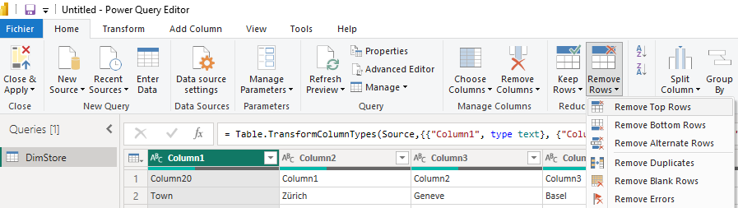
Transposition
Delete the first line

Slide 4
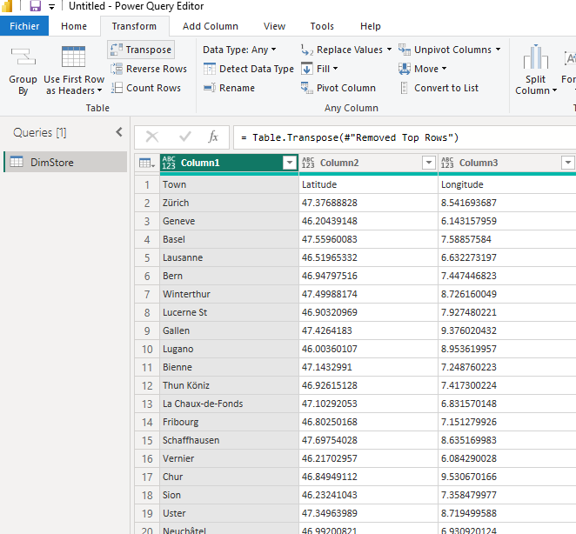
Transposition
the Transform tab again and click Transpose .
Column1 column , the values are Town , Latitude , Longitude .

Slide 5
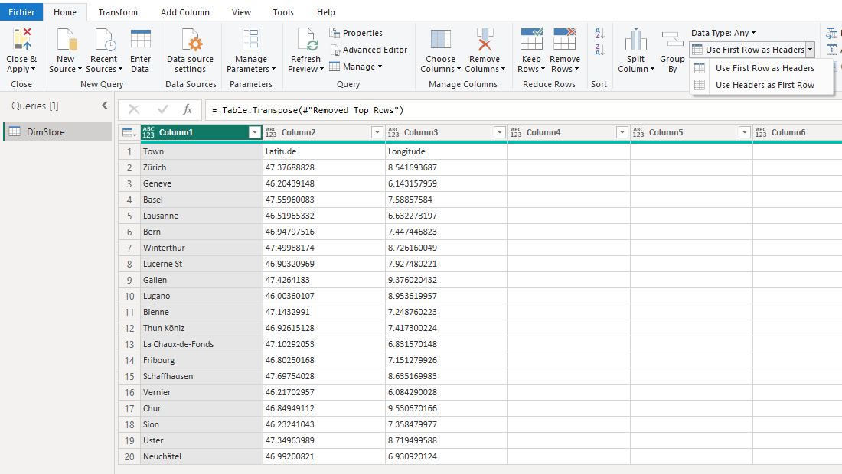
Transposition
Set the first row as column headers.

Slide 6
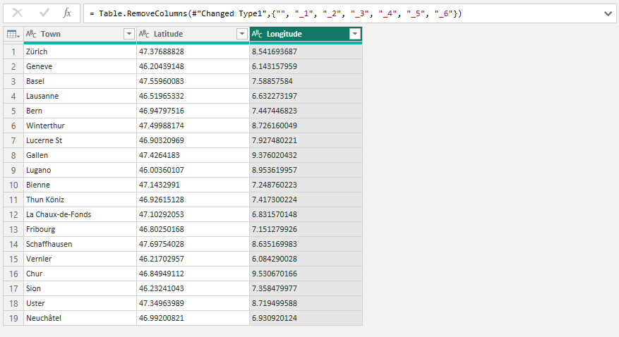
Transposition
Delete unnecessary columns

Slide 7
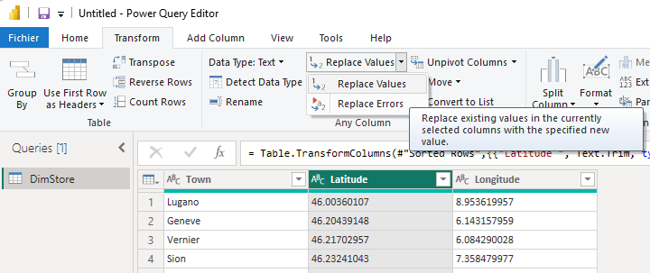
Transposition
Replace the decimal separator "." with "," to prepare for the correct cast
Select the column Longitude .
Come on In Transform → Replace Values .​
Replace all . by , .
Convert then the column in Decimal Number .

Slide 8
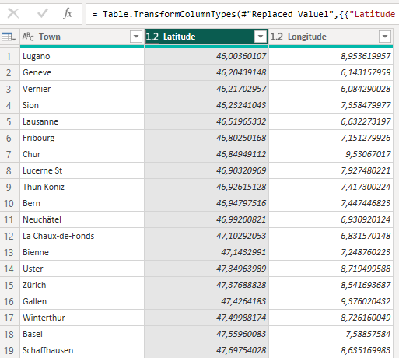
Transposition
The final result after converting column types should be

Slide 9
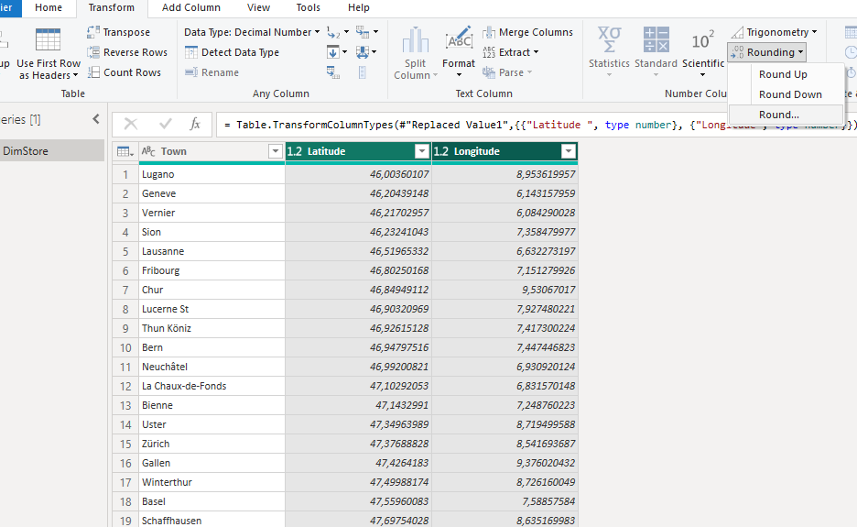
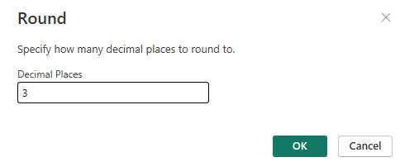
Transposition
It is now possible to round values

Slide 10
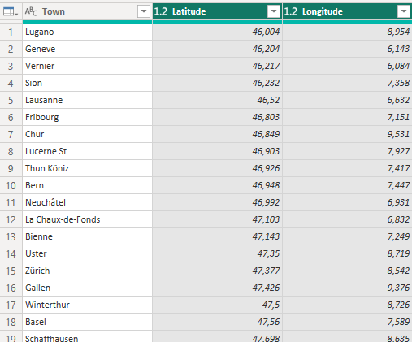
Transposition
The final result should be

Slide 11
Transposition
The final result should be

Slide 12
Thank you
Thank you

